Slide 1

End-to-End Retail Performance and Behavioral Analytics
presented by:
JUWERIYA

Slide 2

Project objective
The objective of this project is to build a data analytics framework that efficiently integrates and analyzes retail data from multiple sources, including sales, customers, products, stores, and returns. The system captures structured details such as revenue, profit, sales channels, customer demographics, store operating costs, product categories, and return reasons.
This analytical approach will assist managers, marketers, and decision-makers in understanding key business dynamics such as revenue growth, customer loyalty, store efficiency, and product return patterns. Ultimately, the project supports smarter, data-driven strategies for improving profitability, optimizing costs, enhancing customer engagement, and strengthening competitiveness in the retail industry.

Slide 3
Main agenda
Data Integration – Sales, Customers, Products, Stores, and Returns.
Data Cleaning & Manipulation – Remove duplicates, fix missing values, standardize formats.
SQL Analysis – Extract profit, customer trends, and returns.
Exploratory Data Analysis (Python) – Identify patterns, outliers, and business insights.
Visualization (Power BI) – Interactive dashboards for Sales, Stores, Customers, and Returns.

Slide 4

introduction
The Retail Industry is highly dynamic, with sales performance, customer behavior, store efficiency, and product returns influencing overall profitability. By leveraging SQL, Python, and Power BI, we aim to gather and analyze key information such as Revenue, Profit, Customer Demographics, Store Costs, and Return Patterns, which can be used to identify business trends and operational bottlenecks.
The project will utilize Python libraries like Pandas for data manipulation, and Power BI for visualization, ensuring accuracy, efficiency, and interactive insights.
Ultimately, the project seeks to enhance transparency in retail operations, empowering stakeholders to make data-driven decisions that align with current market conditions and customer expectations.

Slide 5

Tools used
Software Requirement:-
→ Python(Jupyter notebook)
→ Powerbi
→ Excel
Main Software Libraries:-
→ Pandas
→ Numpy
→ CSV

Slide 6
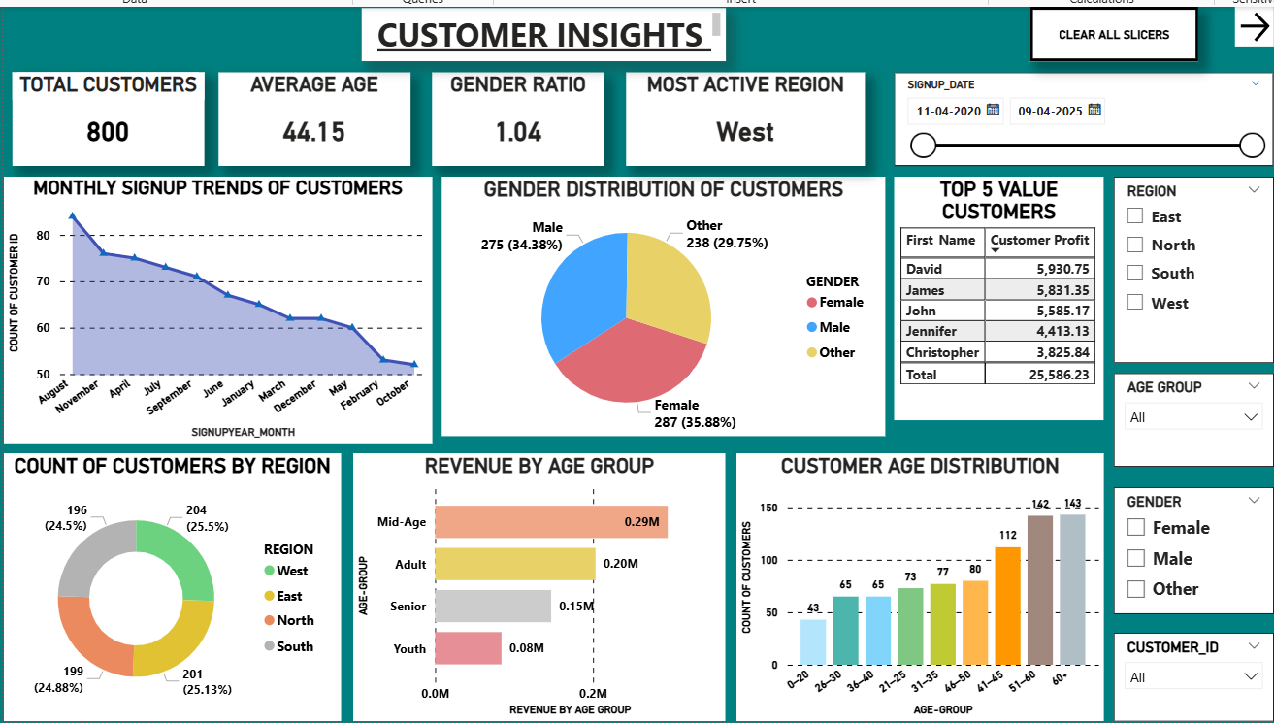
Customers dashboard

Slide 7
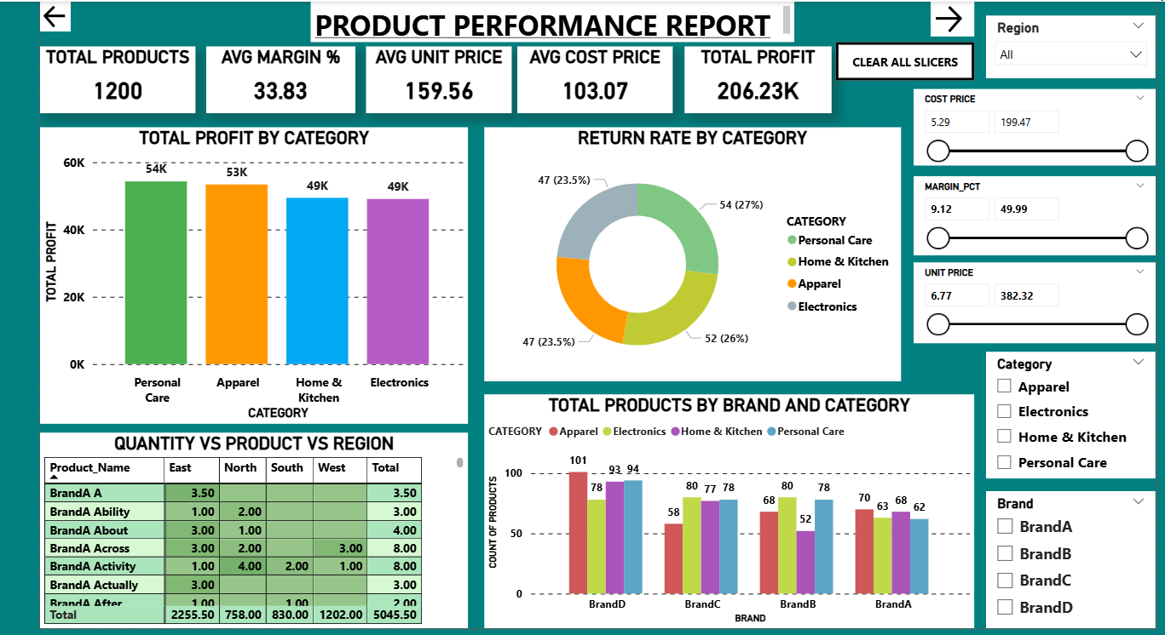
Products dashboard

Slide 8
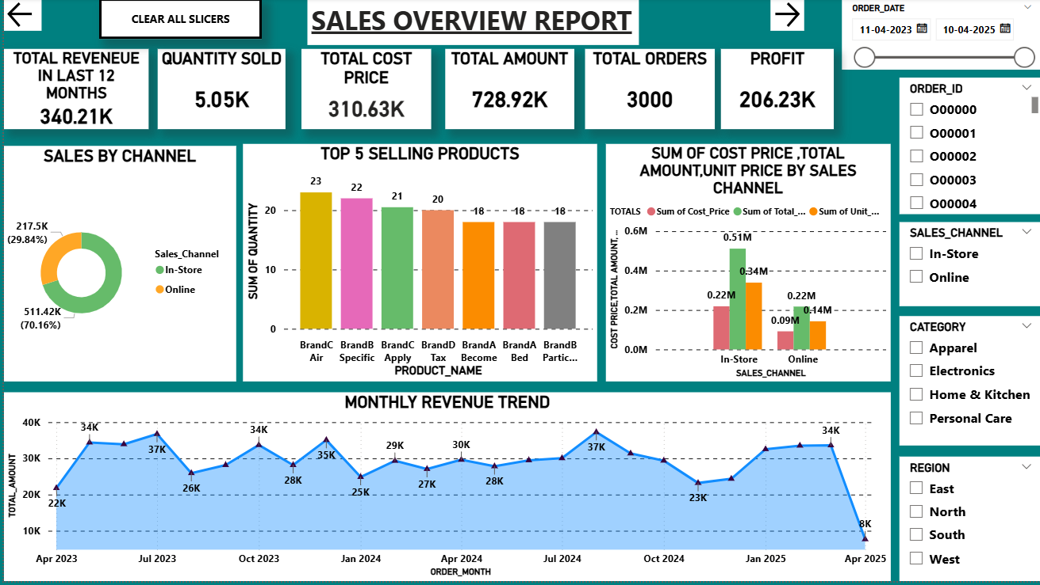
Sales dashboard

Slide 9
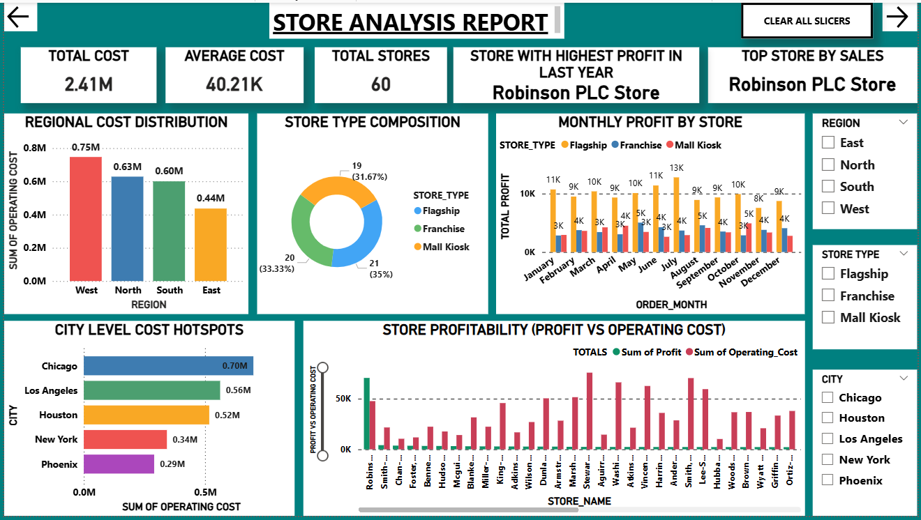
Stores dashboard

Slide 10
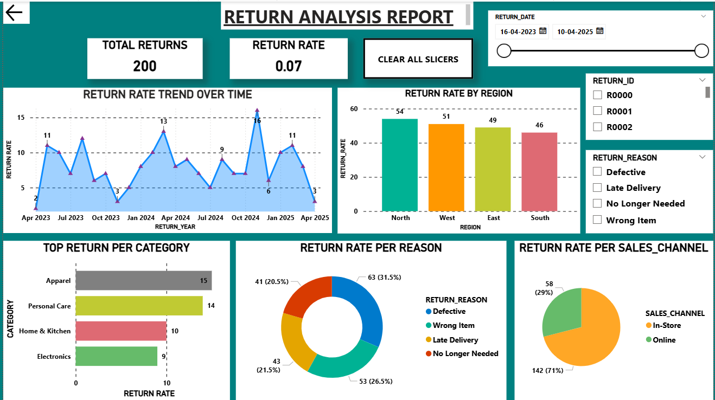
Returns dashboard

Slide 11

Key insights
Customer Insights
800 customers, avg. age 44.15; balanced gender ratio 1.04.
West region most active, but signups declining since 2022.
Mid-age group drives highest revenue; youth lowest.
Top 5 customers contribute ₹25.6K profit → loyalty is key
Product Performance
1,200 products, ₹206.23 K profit, avg. margin 34%.
Personal Care & Apparel lead in profit; Electronics lowest.
High return rate in Personal Care (27%).
East & West regions dominate sales; North lags.

Slide 12

Key insights
Sales Overview
₹340K revenue in last 12 months, ₹206K profit.
Online sales contribute 70% of revenue.
Top products: BrandC Air, BrandB Specific.
Revenue trend declining → need seasonal push.
Store Analysis
60 stores, total cost ₹2.41M, avg. cost ₹40K.
West region costliest; Robinson PLC most profitable.
Flagship stores dominate (35%).
Chicago leads cost hotspots → efficiency gap.

Slide 13
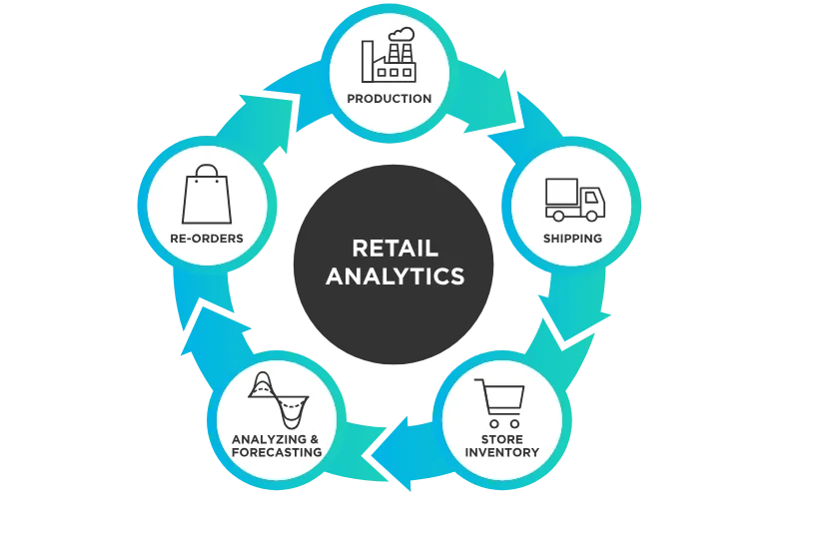
Key insights
Return Analysis
200 returns, overall return rate0.07%.
North has highest returns; Apparel most affected.
Main reasons: Defective (31%), Wrong Item (27%).
71% returns from online → e-commerce fulfillment issue.

Slide 14
Thank you

